Slide 1





BI
360 PROJECT
ATLIQ HARDWARE & TECHNOLOGIES

Slide 2



CONTENT
01
02
03
04
Project Overview
Finance Dashboard
Marketing Dashboard
Sales Dashboard
05
06
07
08
Supply Chain Dashboard
Executive Dashboard
Skills Gained
Business Impact & Conclusion

Slide 3



PROJECT OVERVIEW
Objective: Provide a 360-degree view of business performance across key domains.
Business Domains Covered:
Finance
Marketing
Sales
Supply Chain
Executive Performance

Slide 4



GOALS AND OBJECTIVES
🎯 Goals :
Provide a 360° business view across Finance, Sales, Marketing, Supply Chain & Executive insights.
Enhance decision-making with real-time data and KPI tracking.
Streamline data processing with Power BI for efficiency and accuracy.
Improve operational efficiency by identifying trends and bottlenecks.
Enable forecasting & predictive analysis for better planning.
Ensure data accuracy & accessibility with clean, interactive dashboards.
📌 Objectives :
Develop dashboards tailored to key business areas.
Use Power Query & DAX for data transformation & advanced calculations.
Design user-friendly, interactive visuals with dynamic insights.
Track key metrics like Net Sales, GM%, Profit%, and Forecast Accuracy.
Integrate multiple data sources for scalability and real-time updates.
Optimize reporting & sharing via Power BI Services for collaboration.

Slide 5

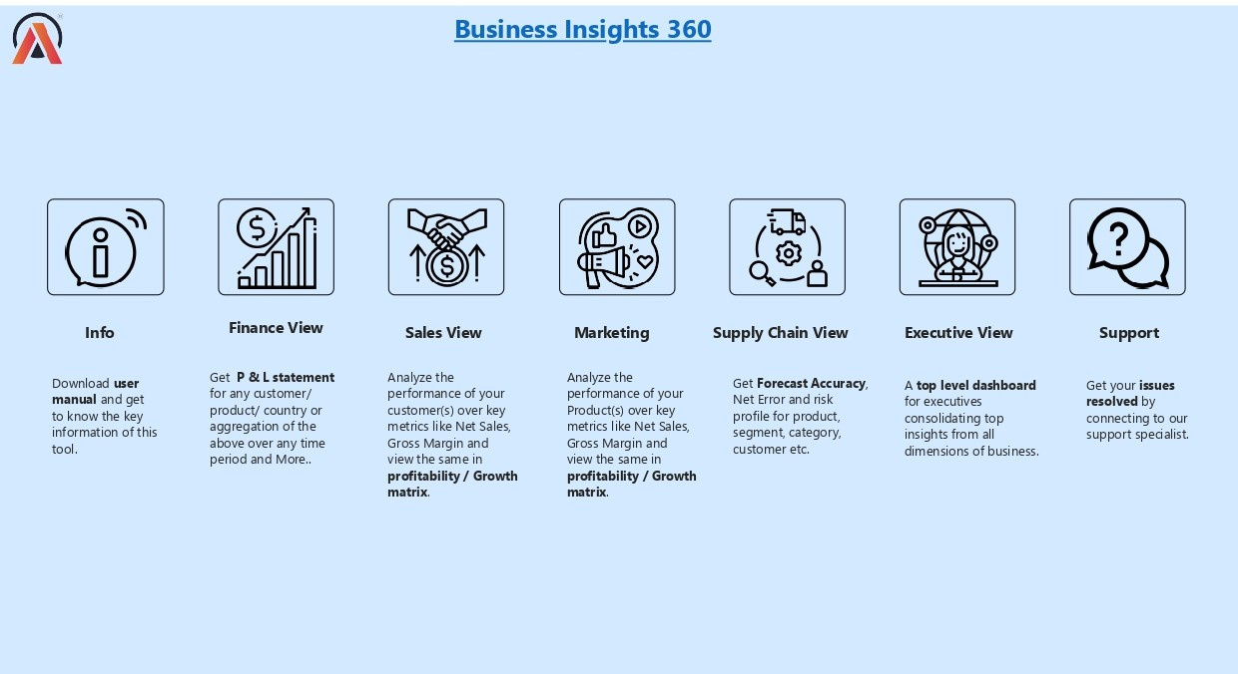
ABOUT US

Slide 6
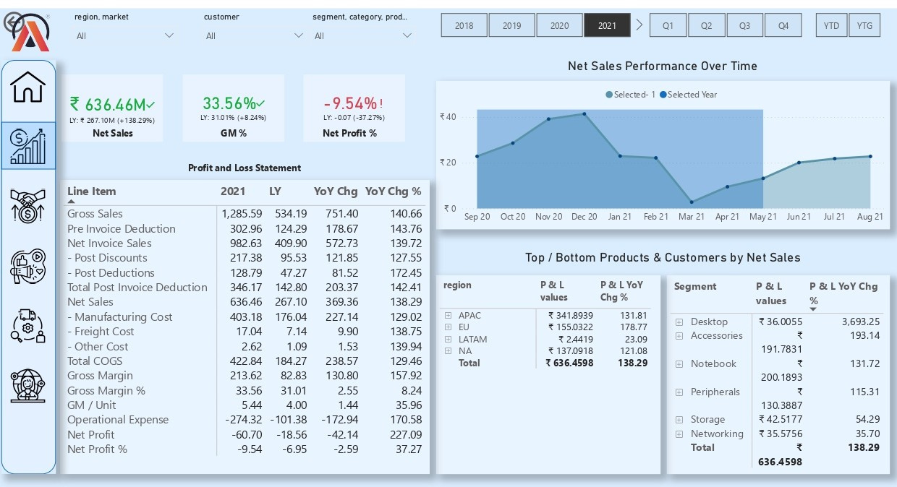

FINANCE VIEW
Key Insights:
Profit & Loss (P&L) Statements
Top/bottom products & customers by Net Sales
Net Sales trends over time
KPIs: Net Sales, Gross Margin (%), and Net Profit (%

Slide 7
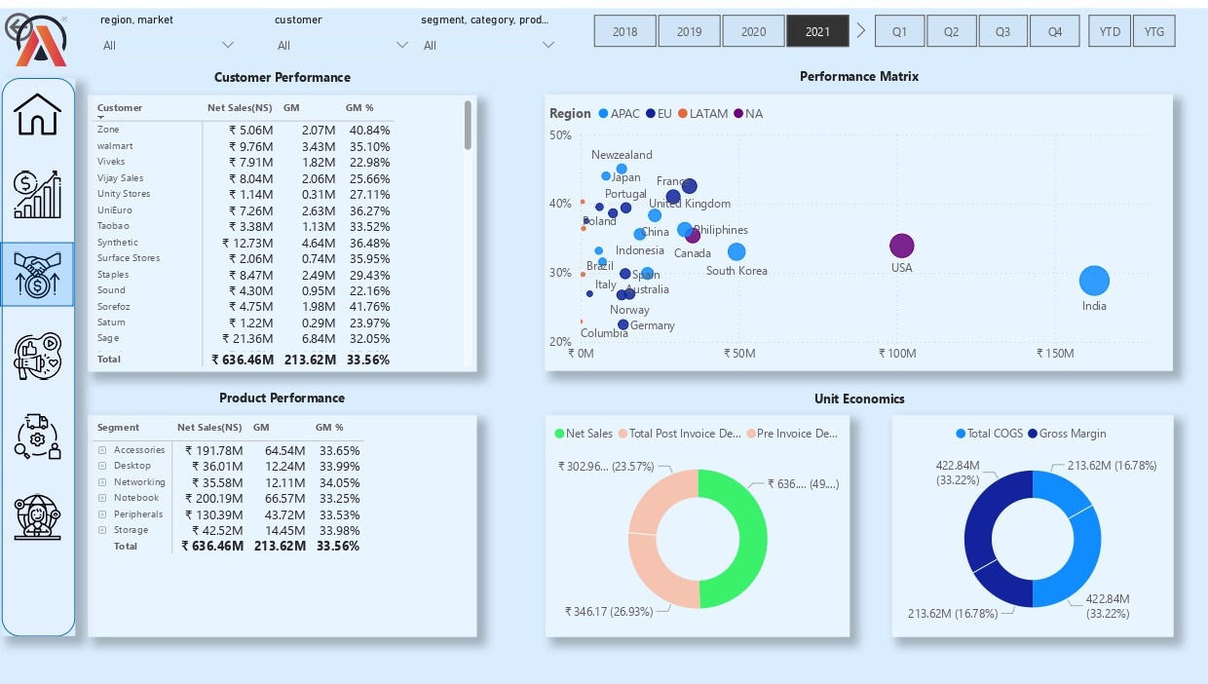
SALES VIEW
Key Insights:
Customer & product performance metrics
Sales performance by region & GM%
Unit Economics analysis

Slide 8
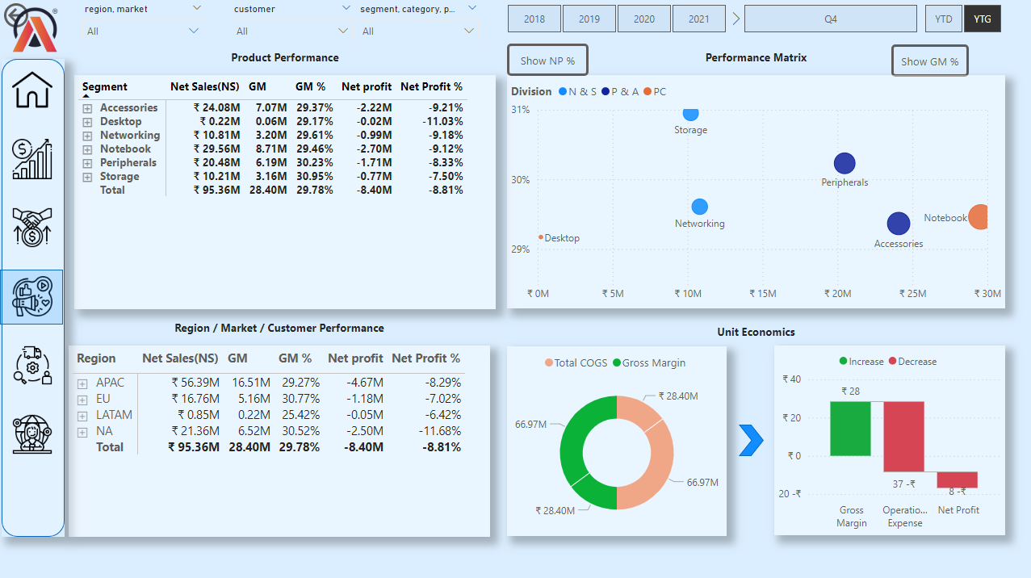
MARKETING VIEW
Key Insights:
Customer & product performance analysis
Divisional performance metrics
Unit Economics: COGS & Gross Margin (GM)

Slide 9
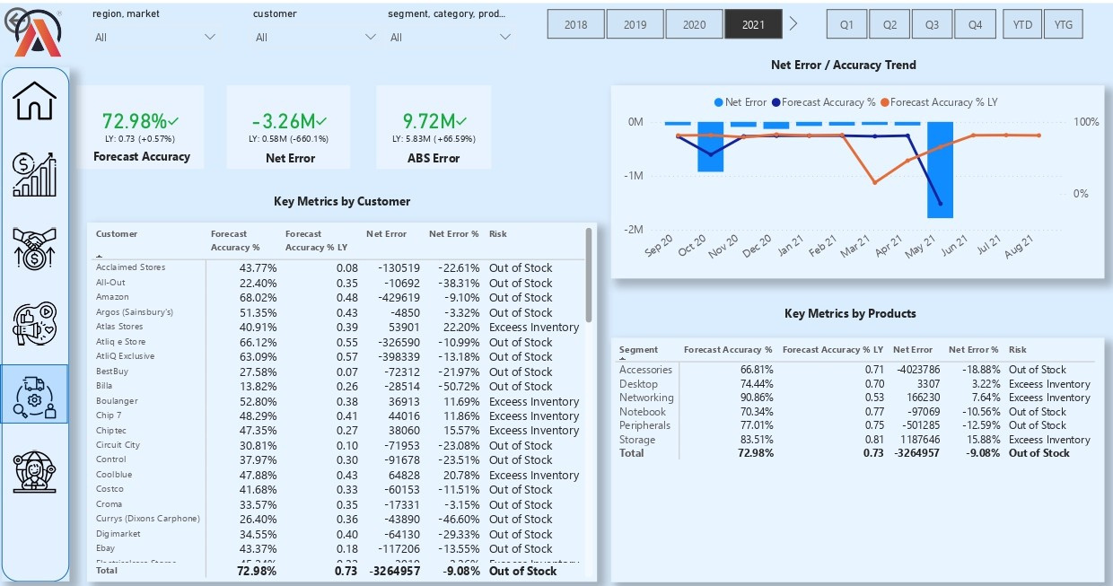
SUPPLY CHAIN VIEW
Key Insights:
Forecast Accuracy % & Net Error analysis
Trends in Accuracy & Net Error for operational improvements

Slide 10
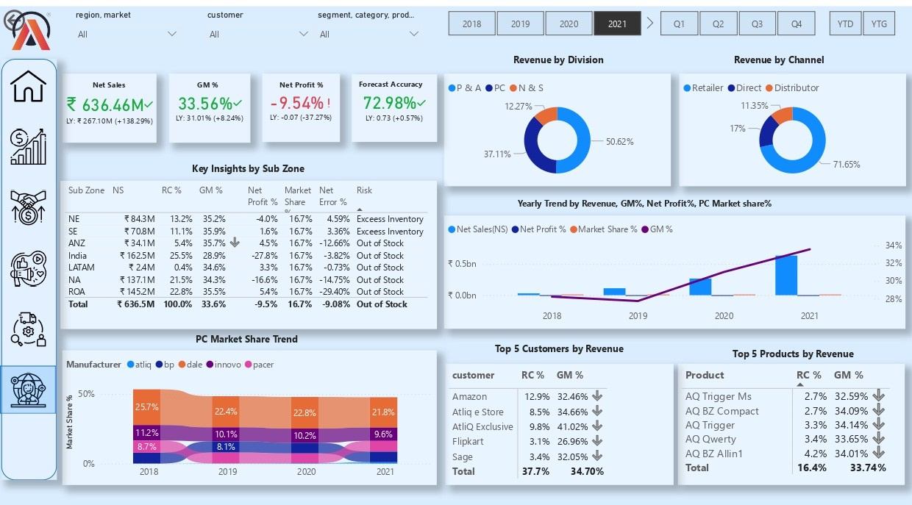
EXECUTIVE VIEW
Key Insights:
Market share trends
Revenue distribution analysis
Top customers/products by revenue

Slide 11
SKILLED GAINED
Data transformation & cleaning using Power Query
Advanced DAX calculations & KPI metrics
Data modeling & relationships in Power BI
Dynamic visuals & conditional formatting
Dashboard design for actionable insights
Publishing & sharing via Power BI Services

Slide 12







ATLIQ HARDWARE
THANK'S FOR WATCHING

Slide 13




RESOURCE PAGE
MAIL
GITHUB
CONTACT
LIVE VIEW
LINKEDIN

